Slide 1
Evaluating Enrollment to Employment Pathways: Integrated Service Delivery in Workforce Development, Education, and Social Benefits Programs Robert McGough – ARDATA Nathan Barrett – Coleridge Initiative

Slide 2
Precursor to Driving Insights from Data
What questions can’t you answer with the data and infrastructure you have available to you?
Necessary conditions
The platform, training, and products are necessary to driving insights from data, but on their own insufficient
Assumes that data sharing agreements are in place that authorize the connection and use of different data systems
This is nontrivial work that is foundational to everything that follows

Slide 3
Driving Insights from Data
What questions can’t you answer with the data and infrastructure you have available to you?
Policy questions can be increasingly complex and require robust data infrastructure
Cross-state mobility
Accounting for multiple services
Necessary conditions
Platform
Host data from disparate sources while retaining data stewardship oversight
Provide access for approved use cases and users
Training
Building capacity to understand and leverage the infrastructure – technical and applied
Provides a place for R&D
Products and Practice
Institutionalizing the use of the data infrastructures through products and their use

Slide 4
Platform

Slide 5
ADRF
Secure cloud-based data and computing environment that supports agencies and researchers in the development of evidence for policy and programs.
FedRAMP Authorized
Customizable configurations to meet various agency and researcher needs
Operates under the five-safes framework

Slide 6
Five Safes Framework
Safe Projects
Safe People
Safe Settings
Safe Data
Safe Exports
Appropriate Use of Data
Only agency approved projects and data sets
Only approved members can access the isolated project workspaces
Controlled access to resources
No shared environment between projects and resources
Trained and Authorized Researchers
Only approved researchers are permitted to access project workspaces
User on-boarding process includes signing data use agreements, terms of use, security training module
Data resources are explicitly granted based on project requirements
Data resources are strictly in a read-only mode to ensure the integrity of the source data
Security protocols follow strict FedRAMP guidelines
Prevents Unauthorized Use
Provides secure methods for agency micro-data transfer
Only agency authorized personnel are invited to perform data transfers
The transfer of data uses the FedRAMP Authorized, FIPS 140-2 validated, Kiteworks Secure Environment
The transfer of data is restricted to upload operations only
Additional security protocols include vulnerability scanning and third-party penetration testing
Protect Data Confidentiality
Data Hashing - A custom stand-alone application simplifies and facilitates the hashing of data prior to transmission to the ADRF
Data Stewardship - a web-based portal for data stewards to manage and monitor project and associated resources including project configurations, user activity, user onboarding status, and overall cost of a project on the ADRF etc.
Non-Disclosive Exports
Prevents users from unauthorized removal of any information within the secure environment
Export requests are reviewed by data stewards following agency guidelines (e.g. proper cell suppression, no complementary disclosures, rounding and noise applied, no references to disclosive specific observations)
Maintain a log of export requests for auditing purposes and to evaluate subsequent requests for complementary disclosure

Slide 7
Training

Slide 8
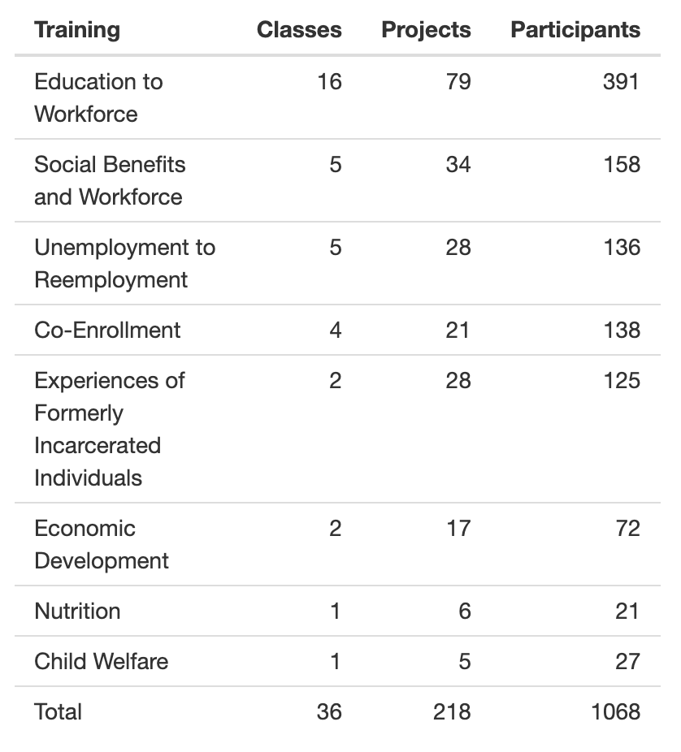
Trainings to Date
36 trainings
1000+ participants
340+ organizations
40+ states

Slide 9
The Approach
Development
Work with agency partner to establish the research question and required data
Project template
Build coding notebooks
Syllabus and lectures
Delivery – Combination of lectures and facilitated team breakouts
Foundations– Coding principles
Module 1 – Data preparation and exploration
Module 2 – Analytics
Final presentation

Slide 10
Core Principles
Every class is bespoke
Topics best learned through a hands-on approach with actual micro-level administrative data
Data science is a team sport – Multiple agencies and skills represented
Project-based - Teams develop their own research topic within the scope of the class
Not a dissertation but the work must provide the foundation for something that is timely, relevant, and actionable
The training can always be improved

Slide 11
Products

Slide 12
The Approach
Products should be thought of broadly
Anything that improves the construction and use of data infrastructure and/or enhances the ability to communicate evidence to a broad community of stakeholders.
Principles
Must be developed in partnership
Timely, actionable, relevant
Intentionally iterative
Scalable
Accessible
Stakeholders must be aware they exist

Slide 13
Data Dashboards
Training classes have led to dozens of promising opportunities integrated across data systems
Formalizing these opportunities can facilitate
Quickly reproducible code bases
Consistency and scalability
Tiered Access
Overlays
Digital twin

Slide 14
What Does This Look Like in Practice?
Every state has a different starting point, and there are multiple on ramps and ways to benefit
Sharing data is not a requirement for participation and can happen when feasible and valuable for each state
Options can include attending training programs, participating in the Multistate Data Collaborative community of practice and working groups, adopting products, facilitating in-state data sharing and use, multistate and cross-sector data sharing, or even developing your own programs based on state priorities.
Notes:
*Maybe Nate can finish off with this one and then hand over to Robert for AR journey

Slide 15
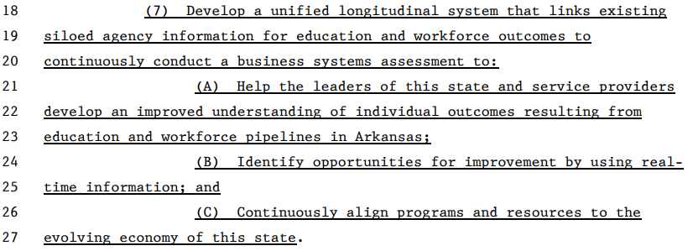
Arkansas’ Journey: Motivating Drivers
2019 legislation charged the Arkansas Data Office (ARData) with development of an SLDS to develop an improved understanding of outcomes, identify opportunities for improvement, and align programs and resources with evolving needs
Notes:
*Robert pick up here

Slide 16
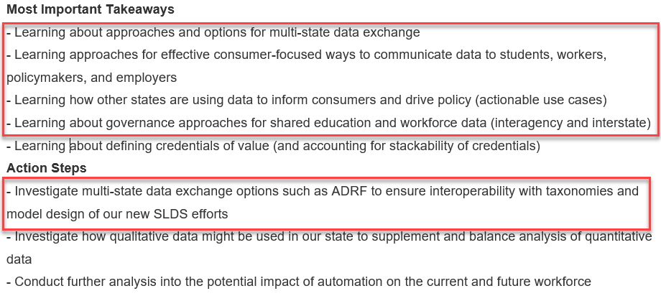
Arkansas’ Journey: Initial Interest
The Arkansas team first learned of the ADRF at the 2019 SHEEO data convening and added it to our takeaways and action steps
Notes:
*Potential call to action: Every state will be working on new action steps - maybe that should include exploration of ADRF :)

Slide 17
Arkansas’ Journey: Exploration and Learning
To learn best practices from other states and explore the ADRF as an option, Arkansas participated in several training programs hosted by other states and organizations, all of which benefited AR in practice:
Transitions in Education and Work (OH 2020)
Developed nursing pathway study approach in use today
Unemployment to Reemployment (ETA/IL 2021)
Developed workforce dashboard being deployed today
Transitions in Education and Work (TN 2021)
Developed higher education student migration model used today
Leveraging Big Data to Achieve Equity (UNCF/Excelencia 2021)
Informed approaches used by a statewide workforce equity study
Value Data Collaborative (IHEP 2022)
Provided valuable learnings for credentials of value measurement
Notes:
*Potential call to action: Every state will be working on new action steps - maybe that should include exploration of ADRF :)
We got value from every program, before we were ever sharing data

Slide 18
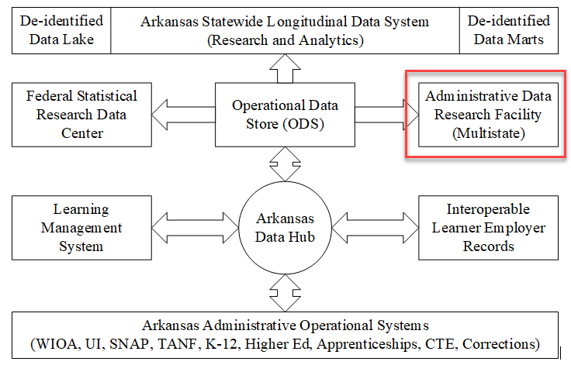
Arkansas’ Journey: Participation
Arkansas’ first participation in sharing data through the ADRF started in 2021, as a key component of our new architecture under the Workforce Data Quality Initiative (followed by JRI, IES SLDS, and Medicaid)
Notes:
*Potential call to action: Every state will be working on new action steps - maybe that should include exploration of ADRF :)
We got value from every program, before we were ever sharing data

Slide 19
Arkansas’ Journey: Contribution
In 2022, Arkansas worked with the Coleridge Initiative to develop a new Applied Data Analytics training program focused on work-based learning to support state initiatives to scale and align WBL in Arkansas. Five teams from AR, MO, and CA completed projects leading to valuable insights and products:
From Trained to Retained: An Analysis of Retention Outcomes for RAP Completers
Apprenticeship Experience of Justice-Involved Individuals in Arkansas: Barriers to Success
Retention Trends Within Arkansas’ WBL-to-Workforce Pipeline
Registered Apprenticeship Programs: Does Completion Matter?
Work-Based Learning: What is the Current Reality in Arkansas?
Notes:
*Potential call to action: Every state will be working on new action steps - maybe that should include exploration of ADRF :)
We got value from every program, before we were ever sharing data

Slide 20
Arkansas’ Journey: Sharing
In 2022, Arkansas switched from sending data files out to researchers to bringing researchers to the data in the Arkansas ADRF environment.
This has made the process of facilitating secure researcher access to data more efficient for everyone involved, facilitated improved monitoring and control over access, use, and disclosure, and reduced the risk of sharing.
With over 70 Arkansas government staff trained in evaluation and research in the ADRF, this also facilitates more efficient state capacity.
By leveraging an ever-expanding linked longitudinal data set, models, methods, and expertise (more than just data), the deltas continue to shrink and we are achieving accelerating velocity from question to insight with repeatable shared service products for common needs.
Notes:
*Potential call to action: Every state will be working on new action steps - maybe that should include exploration of ADRF :)
We got value from every program, before we were ever sharing data

Slide 21
Enrollment to Employment (E2E)
In 2023, Arkansas worked with the Coleridge Initiative to develop an Applied Data Analytics training program on “Evaluating Enrollment to Employment Outcomes” (E2E).
The program is designed to facilitate evaluation, research, and product development related to integrated service delivery (ISD) across education,workforce development (WIOA), WBL (RAPS), and social benefit (SNAP, TANF) programs.
The program is being delivered over 5 cohorts of 30 students each representing over 40 states. 2 are provided via AR WDQI. 3 are supported by DOL ETA and NASWA.

Slide 22
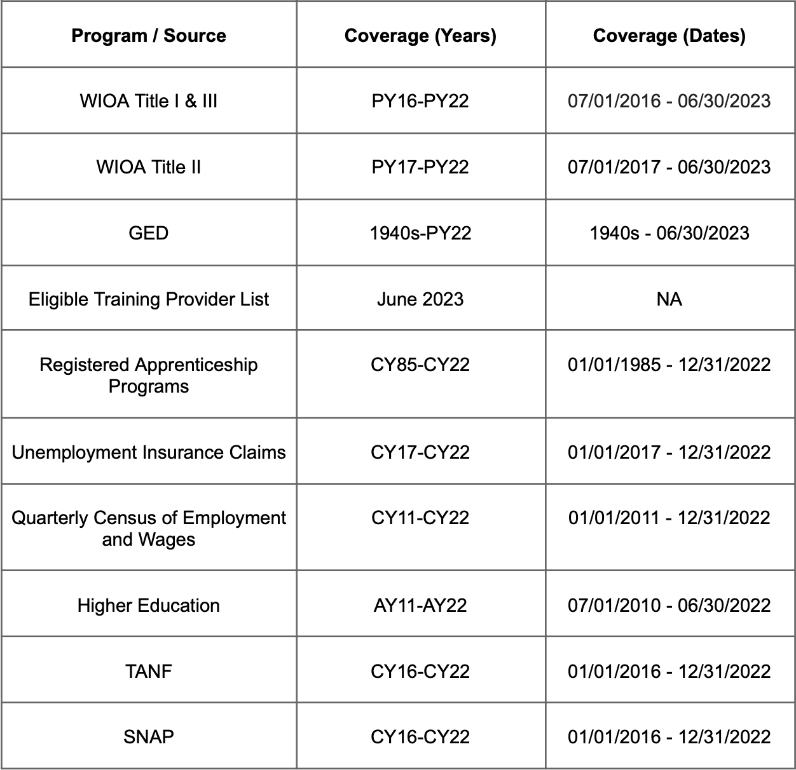
E2E Interagency Data Sharing
Development of the data sharing agreements for the program facilitated some new sharing of Arkansas data across numerous department and programs that is providing benefits beyond facilitating the program and related projects.
Notes:
Development of the data sharing agreements and project space for the program facilitated interagency sharing of Arkansas data across numerous department and programs (show list, table, image of the breadth of data involved).

Slide 23
E2E Interstate and Cross-Sector Data Sharing
The E2E program (like many ADA programs before it) is bringing value to participants from other states and sectors by facilitating secure access to real administrative data and subject matter expertise across a wide breadth of programs, facilitating some analyses not previously possible.
Knowledge sharing often continues after the program through a growing community of practice.
The curriculum itself did not start from scratch and resulted from years of successive collaborative development, improvement, and sharing of an evolving curriculum library that has been delivered to (and improved by) over 1K participants.
Notes:
Development of the data sharing agreements and project space for the program facilitated interagency sharing of Arkansas data across numerous department and programs (show list, table, image of the breadth of data involved).

Slide 24
E2E Sharing of Value
The E2E teams are producing data products with actionable value to states which are collaboratively developed, shared, and scaled.
The multi-state and cross sector teams and cohorts are rapidly expanding the body of knowledge on and across these administrative data sets that are leading to data quality improvements and potential enhancements to data collection mechanisms and interoperable record formats.
The curriculum’s focus on integrated service delivery (programs sharing data/referrals and working together) itself is facilitating evaluation and research on the degrees of sharing and integration across programs and potential impacts of increased sharing and integration at the operational level on resident outcomes.
Notes:
Development of the data sharing agreements and project space for the program facilitated interagency sharing of Arkansas data across numerous department and programs (show list, table, image of the breadth of data involved).

Slide 25
E2E Projects
The E2E teams are producing data products with actionable value to states which are collaboratively developed, shared, and scaled.
Class 1:
Effectiveness of Adult Education Programs on Workforce Outcomes
Resulted in development of a Title II PIRL mapping
Stayers, Stutterers, and Leavers
SNAP churn analysis now supporting broader SNAP evaluation and research efforts
Your Arkansas Pathway
Interactive analysis of the multi-step pathways taken by participants and related outcomes
Class 2:
Role of Demographics on Apprenticeship Completion Status (DC)
Job Quality Outcomes from Enrollment in WIOA Youth and Adult Programs (DE, MA)
Efficacy of Single Enrollment vs Co-Enrollment on Job Quality Improvement (MO)
Employment Outcomes of Welfare Recipients in Arkansas (NJ)
The Effects of WIOA Title I Services in the SNAP Population of ABAWDS (OH)
Factors Influencing Apprenticeship Completion and Subsequent Earnings (CT)

Slide 26
What’s Next?
Data Infrastructure
Building a foundation for a Multi State K-12 through education and workforce data system
Correctional Education Opportunities and workforce outcomes
Upcoming Training Opportunities
Prison Education Programs
Value-Data Framework
Education and Workforce Indicator Framework
K-12 through education and workforce
Short Courses

Slide 27
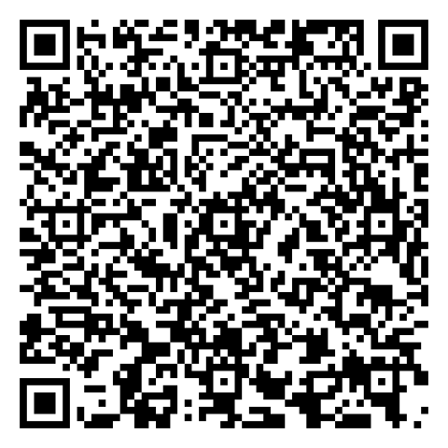
Call to Action
Register for Coleridge’s upcoming convening “Building Bridges, Breaking Barriers: Data Collaboration for the Public Good”
Multi-State Collaboratives

